Slide 1
2016 STATE OF THE REGION
#LOGISYNERGY
John D. Chaffee, President/CEO
April 20, 2016

Slide 2
LOGI•SYN•ERGY
The fusion of logistics and energy and the anticipated impact of both transportation and energy projects planned for ENC.
#LOGISYNERGY

Slide 3
NCEast Mission
to drive the region’s current and future economic development through three core strategies:
Creating growth through targeted business attraction, retention and entrepreneurship promotion - branding, marketing, and professional prospect management
Building Capacity by improving labor skills in the region, enhancing education rates, and supporting infrastructure improvements
Advocating for our institutions, infrastructure needs and communities
#LOGISYNERGY

Slide 4
REGIONAL
PERFORMANCE
#LOGISYNERGY

Slide 5
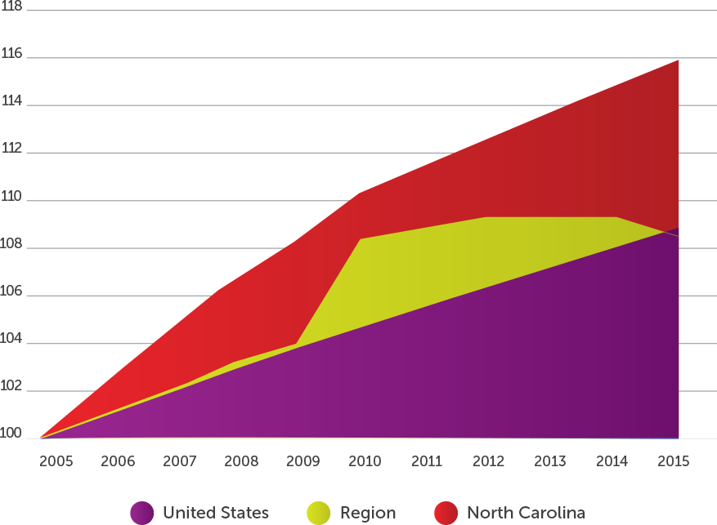
Population Index
Source: US Census Bureau - Historical Data (2002-2009) - Annual Estimates of the Resident Population for Counties, State and National; US Census Bureau - Population Estimates, 2013-2014 County Total Population Estimates
#LOGISYNERGY

Slide 6
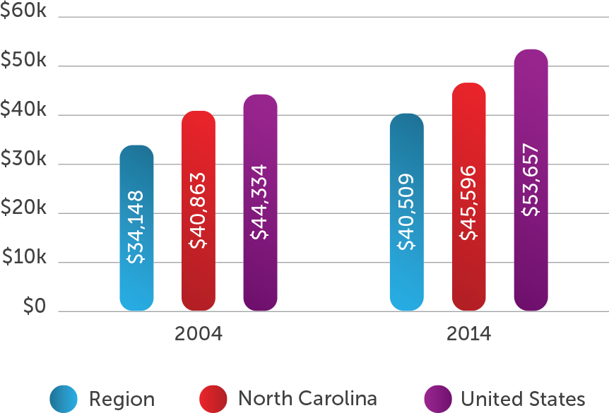
Median Household Income
Source: US Census Bureau, 2009-2014 American Community Survey 5-Year Estimates,
Selected Economic Characteristics and Small Area Income and Poverty Estimates - State and County Estimates for 2011-2014
#LOGISYNERGY
Notes:
ENC still lags state and nation but gaining – ENC up 18% vs NC @ 11% vs US @ 21%

Slide 7
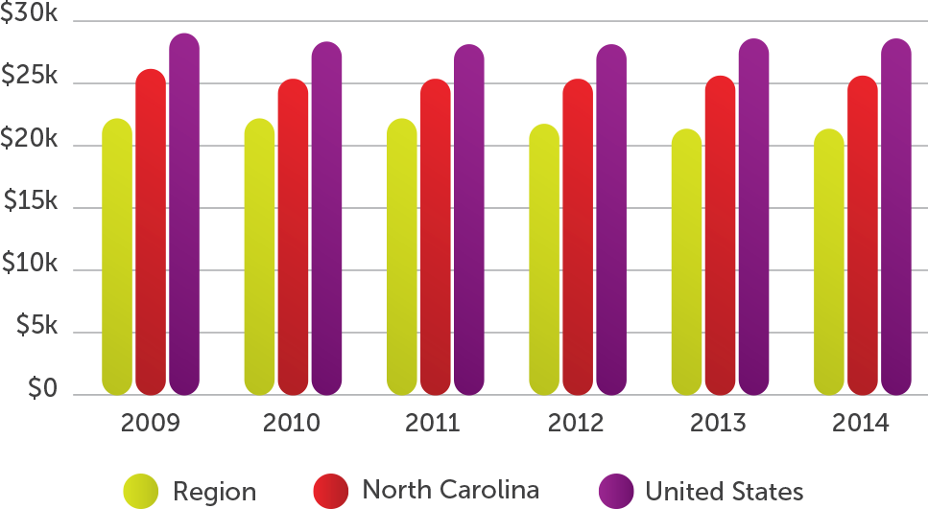
Per Capita Income
Source: US Census Bureau- American Fact Finder, B19301, ACS 5-Year Estimates
#LOGISYNERGY

Slide 8
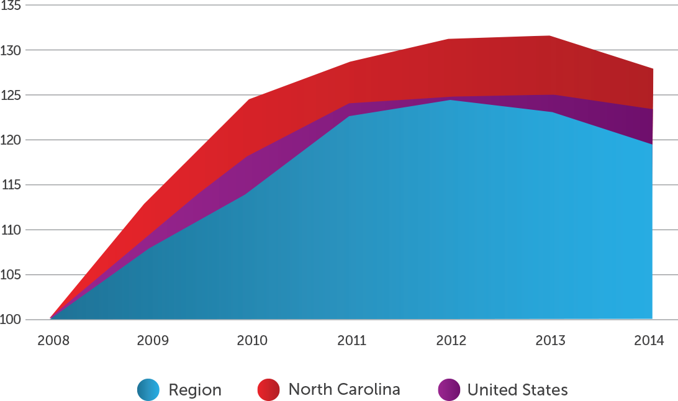
Poverty Index
Source: US Census, 2014 Small Area Income and Poverty Estimates
#LOGISYNERGY

Slide 9
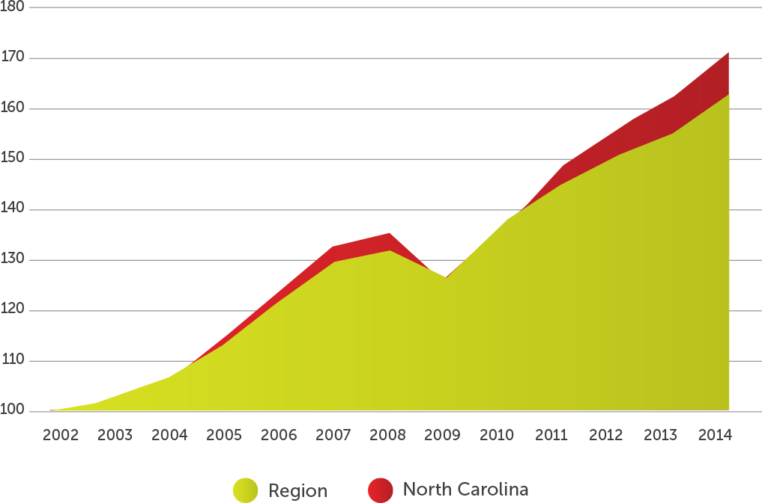
Travel & Tourism Index
Source: NC Department of Commerce- Tourism, Travel Economic Impact Model (TEIM)

Slide 10
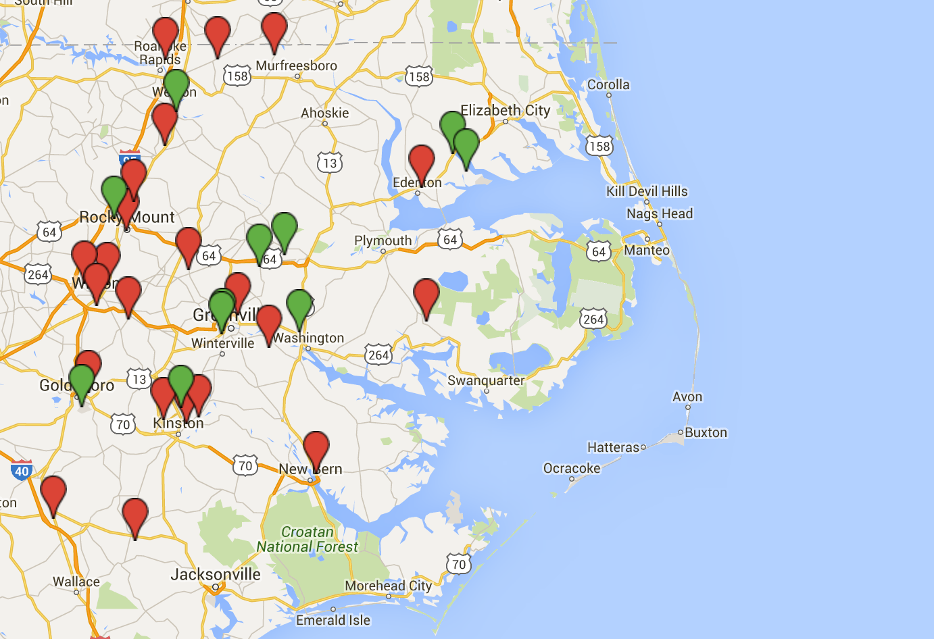
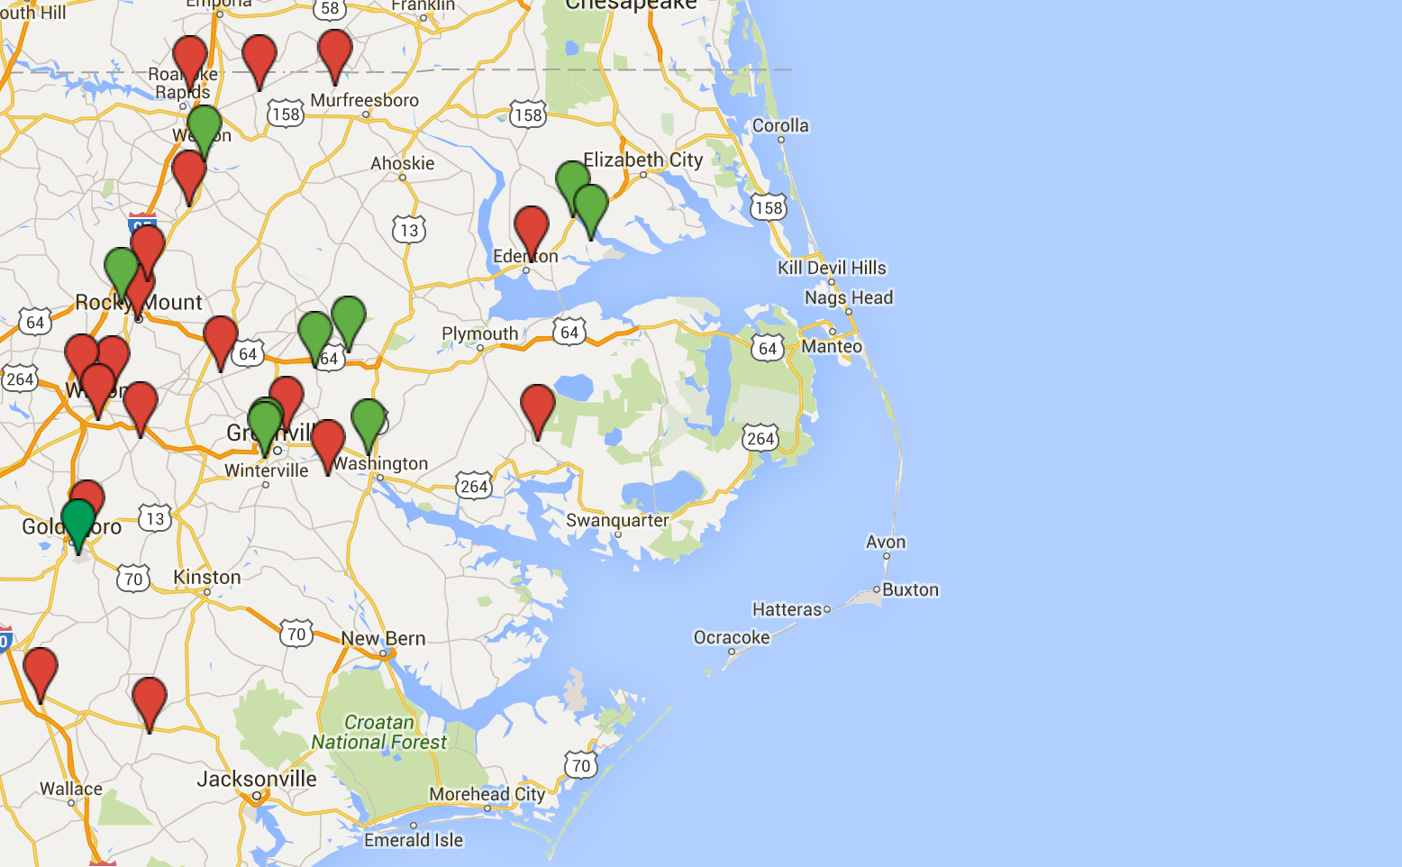
2015 Industrial Announcements
FROM REGIONAL COUNTIES
Advanced Manufacturing
822 jobs
$136M+
Life Science
(Including Healthcare)
142 jobs
$395M+
Logistics
33 jobs
$2.6M+
Motor Vehicle Assembly
& Parts Mfg
0 jobs
$35M
Value- Added Ag
329 jobs
$84M+
New
Existing

Slide 11
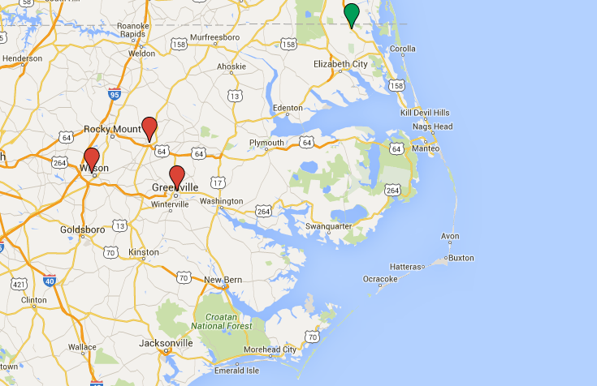
2016 Q1 Industrial Announcements
FROM REGIONAL COUNTIES
New
Existing
$195+ Million
in investments

Slide 12
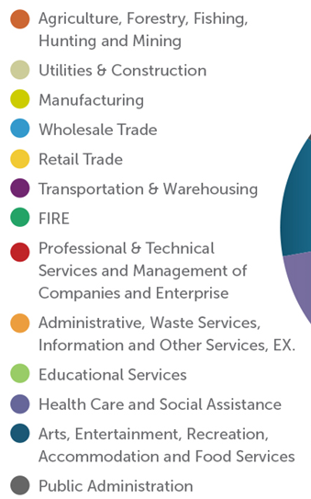
Employment by Industry - 3Q 05
#LOGISYNERGY
Notes:
Next Slide: 2015 3Q - Diversity of regional economy – slight changes over last 10yrs

Slide 13
Employment by Industry - 3Q 15
#LOGISYNERGY
Notes:
those sectors on upper right side of piechart declined (ag, mfg, wholesale trade) but bottom and left side increased (prof services, healthcare, arts). Retail employment also increased. One key - mfg productivity improving

Slide 14
Energy Improvements
Proposed Atlantic Coast Pipeline – bringing new gas supply to ENC that will lower prices and increase reliability
Conversion of Duke power plant (Wayne Co) from coal to natural gas will decrease pollution and solidify regional air quality as attainment
Sale of NC Electric Municipal Power Agency generation to Duke Energy/Progress – bringing stability and lower power costs
Solar energy farms spreading across ENC – over 90 solar farms have been installed in eastern NC bring over $1.2 billion of investment into the region
The Amazon Wind Farm US East, operated by Iberdrola Renewables at Desert Wind, is the first utility-scale wind farm in North Carolina and one of the first in the southeastern US
#LOGISYNERGY

Slide 15
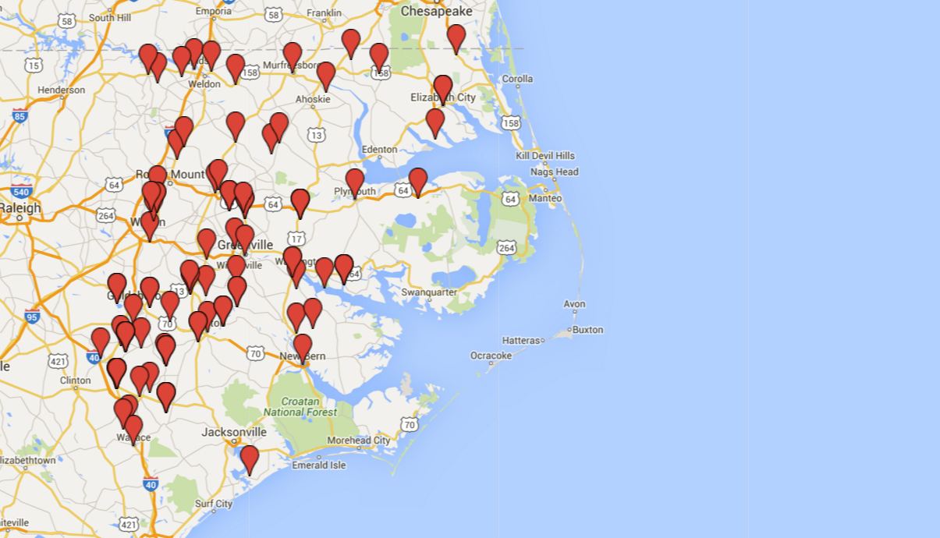
Solar Farm Installations
$1.2 Billion
INVESTMENTS IN THE REGION
Distributed vs concentrated
Investments in rural counties have major impact on tax base
#LOGISYNERGY

Slide 16
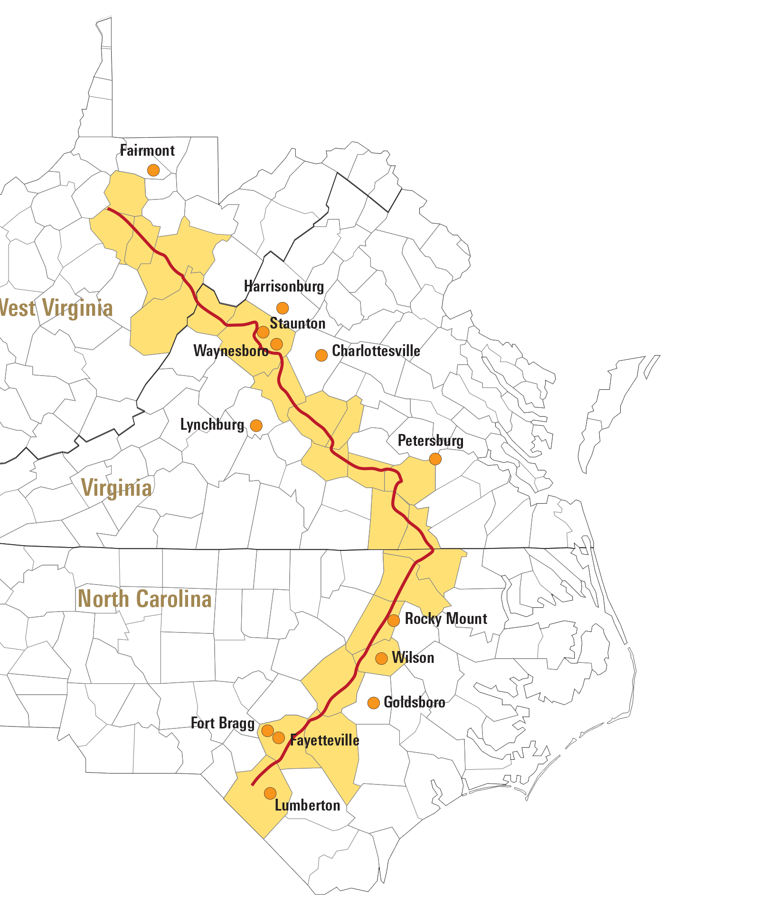
Atlantic Coast Pipeline
Less dependent on outside sources for safe, efficient, reliable natural gas.
$130 million/yr
Bring much-needed jobs during construction - keep hundreds employed through operation
Improve chances of recruiting companies that need natural gas for their production processes.
#LOGISYNERGY

Slide 17
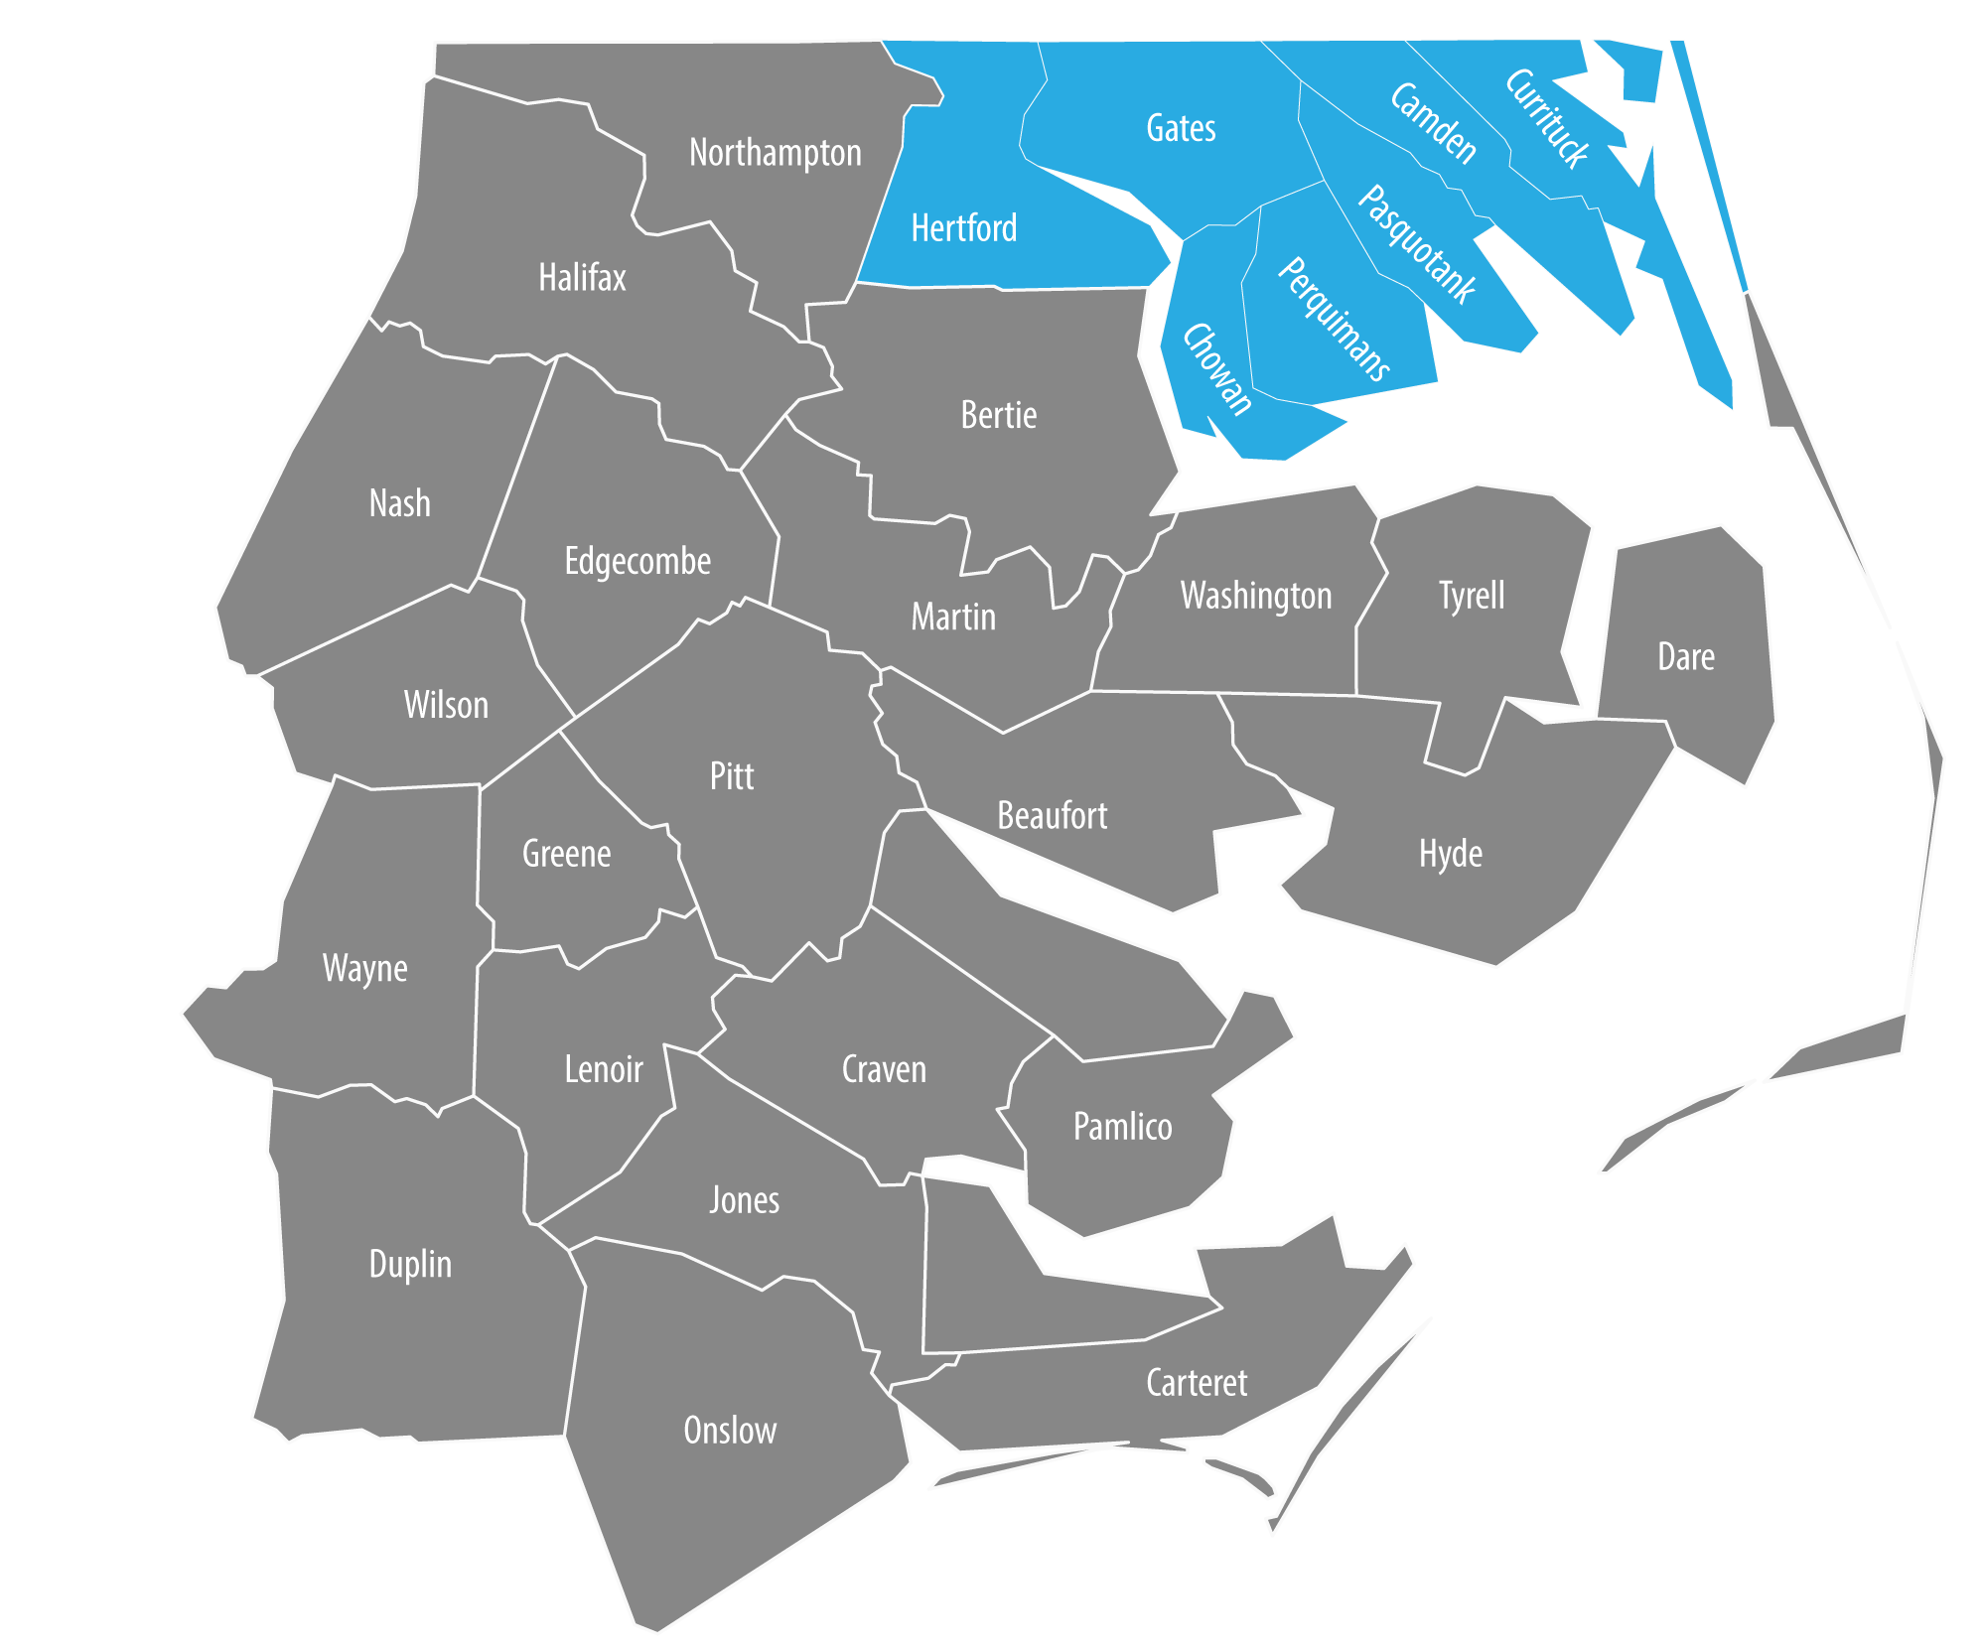
Foreign-Trade Zone #20
Ports of VA expansion of FTZ 20 into Northeastern NC
Companies locating in FTZ 20 can benefit from advanced distribution networks; easy and reliable access to shipping channels, highways, railways, and airways.
#LOGISYNERGY

Slide 18
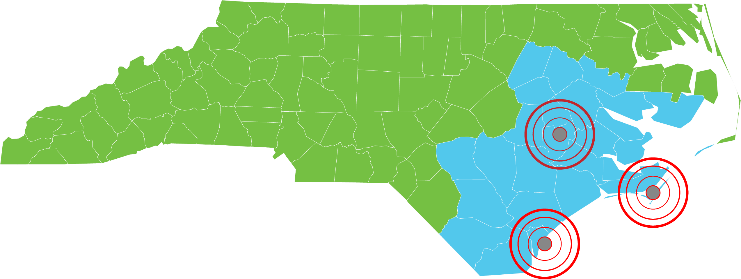
Foreign-Trade Zone #214
Foreign-Trade Zone #214 is located in Southeastern North Carolina (SENC) and offers individuals and businesses in 24 North Carolina counties the opportunity to import foreign goods into a duty-free zone. The N.C. Department of Transportation is the Grantee and oversees FTZ #214 SENC.
Current FTZ #214 Magnet sites include:
N.C. Global TransPark
N.C. State Port at Morehead City
N.C. State Port at Wilmington
Magnet sites are essentially the same as the current general-purpose zone sites with a warehouse operator that has already been approved within FTZ #214 SENC. A magnet site can be used by many importers.
#LOGISYNERGY

Slide 19
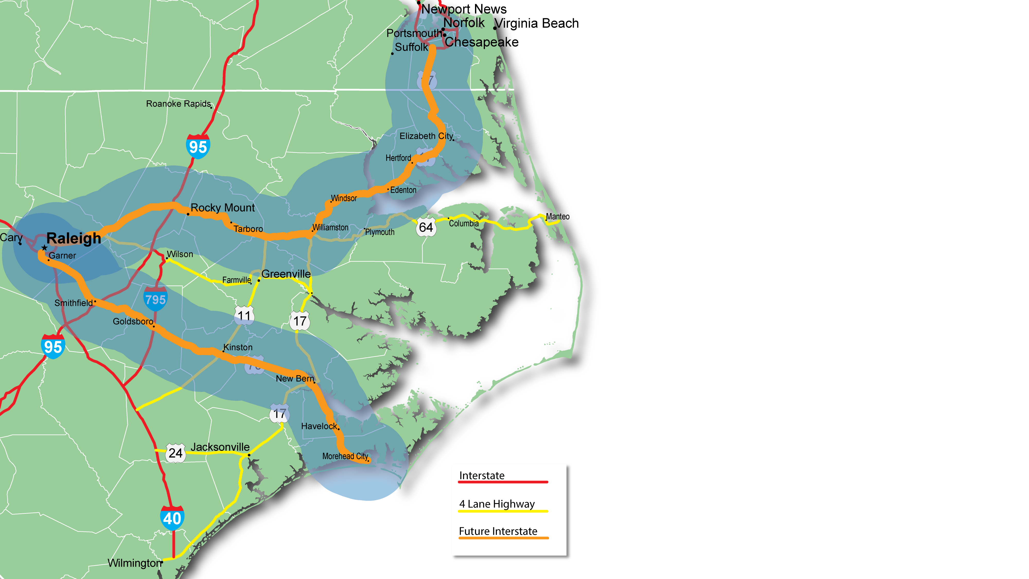
FUTURE INTERSTATE DESIGNATIONS

Slide 20
Interstate Highway Designations
Will Stimulate Growth
I-495 / US 70 / US64
From Raleigh Beltline to Norfolk
Future interstate would follow the I-495 corridor to I-95 at Rocky Mount, following the US 64 freeway then traveling US 17 - connecting to the cities of Chesapeake & Norfolk, VA in the Hampton Roads region.
US 70 CORRIDOR
Improving access from Triangle to Crystal Coast
Bypassing Clayton, Goldsboro, Kinston, Havelock, and Beaufort.
This corridor is heavily used for moving freight, and is just a few miles south of the Global TransPark. Also provides vital connections to two military instillations.
#LOGISYNERGY

Slide 21
Other Infrastructure Progress
Mid-Currituck Bridge - $440 Million
Bonner Bridge - $246 Million
Connectivity Improvements
Goldsboro Bypass - completion June 2016 - $246 Million
SW Greenville Bypass – in development - $231.8 Million
Havelock Bypass – construction 2018 - $173 Million
Maysville Bypass – completion 2018 - $225 Million
Dredging at Beaufort Inlet - improve Port of Morehead City access
Gallants Channel Bridge (Beaufort, NC) - open 2018 - $66 Million
Global TransPark finally a multi-modal facility with construction of rail spur (May 2015) - opening of Goldsboro bypass (June 2016)
#LOGISYNERGY

Slide 22
Proposed Transportation Projects (STI)
County | Mode | Route Name | Cost to NCDOT | Statewide Mobility Score
Johnston | Rail | CSX A-Line | $100,000,000 | 91.83
Craven | Highway | US-70 | $32,224,000 | 88.6
Mecklenburg | Highway | I-77 | $96,620,000 | 86.26
Union | Highway | US-74 | $2,704,000 | 84.12
Cleveland | Highway | US-74 | $17,000,000 | 82.78
The top two rated projects are both in ENC – one in Johnston (CCX) and one in Craven (US70 interchange) for total of $132 million
#LOGISYNERGY

Slide 23
Significant Developments in the Region
Re-launch of Rural Jobs Accelerator Grant (RJA) grant transition from NC Rural Center (USEDA & USDA)
Creation of BioPharma Development & Mfg Center of Excellence by East Carolina Univ. & Pitt CC (2015)
Launch of new Advanced Mfg Center of Excellence at Wayne Community College (2015)
Passing the Connect NC Bond (over $200 Million for ENC)
$90 Million for ECU – bioengineering building
$13 Million for ECSU
$92 Million for Community Colleges
$7+ Million for ENC state parks
#LOGISYNERGY

Slide 24
Military Developments in the Region
KC-46A Stationed at Seymour Johnson AFB
Part of the Air Force’s program to modernize the tanker fleet (2019)
Fleet Readiness Center East at Cherry Point
Site for a new $14 million F-35B vertical lift fan repair facility.
US Coast Guard Elizabeth City Acquires Hangars
Support growth of Aviation Logistics Center
#LOGISYNERGY

Slide 25
NCEAST
ACTIVITY
#LOGISYNERGY

Slide 26
Marketing by the Numbers
PROJECTS
35
73
53
Marketing &
Client Trips
New Projects
CY 2015
Active
Projects
PUBLIC RELATIONS
40
News Releases Issued
288 pickups – Sustainability Excellence in Manufacturing (Article)
248 pickups – Regional Manufacturers Recognized as Leaders in Sustainability (Press Release)
#LOGISYNERGY

Slide 27
2015 Projects by Cluster
21%
14%
10%
5%
21%
5%
4%
11%
4%
5%
Adv Mfg
Life Science
VAA (Food & Ag)
Energy
Auto
Logistics/Distribution
Call Center
Marine
IT
Defense
#LOGISYNERGY

Slide 28
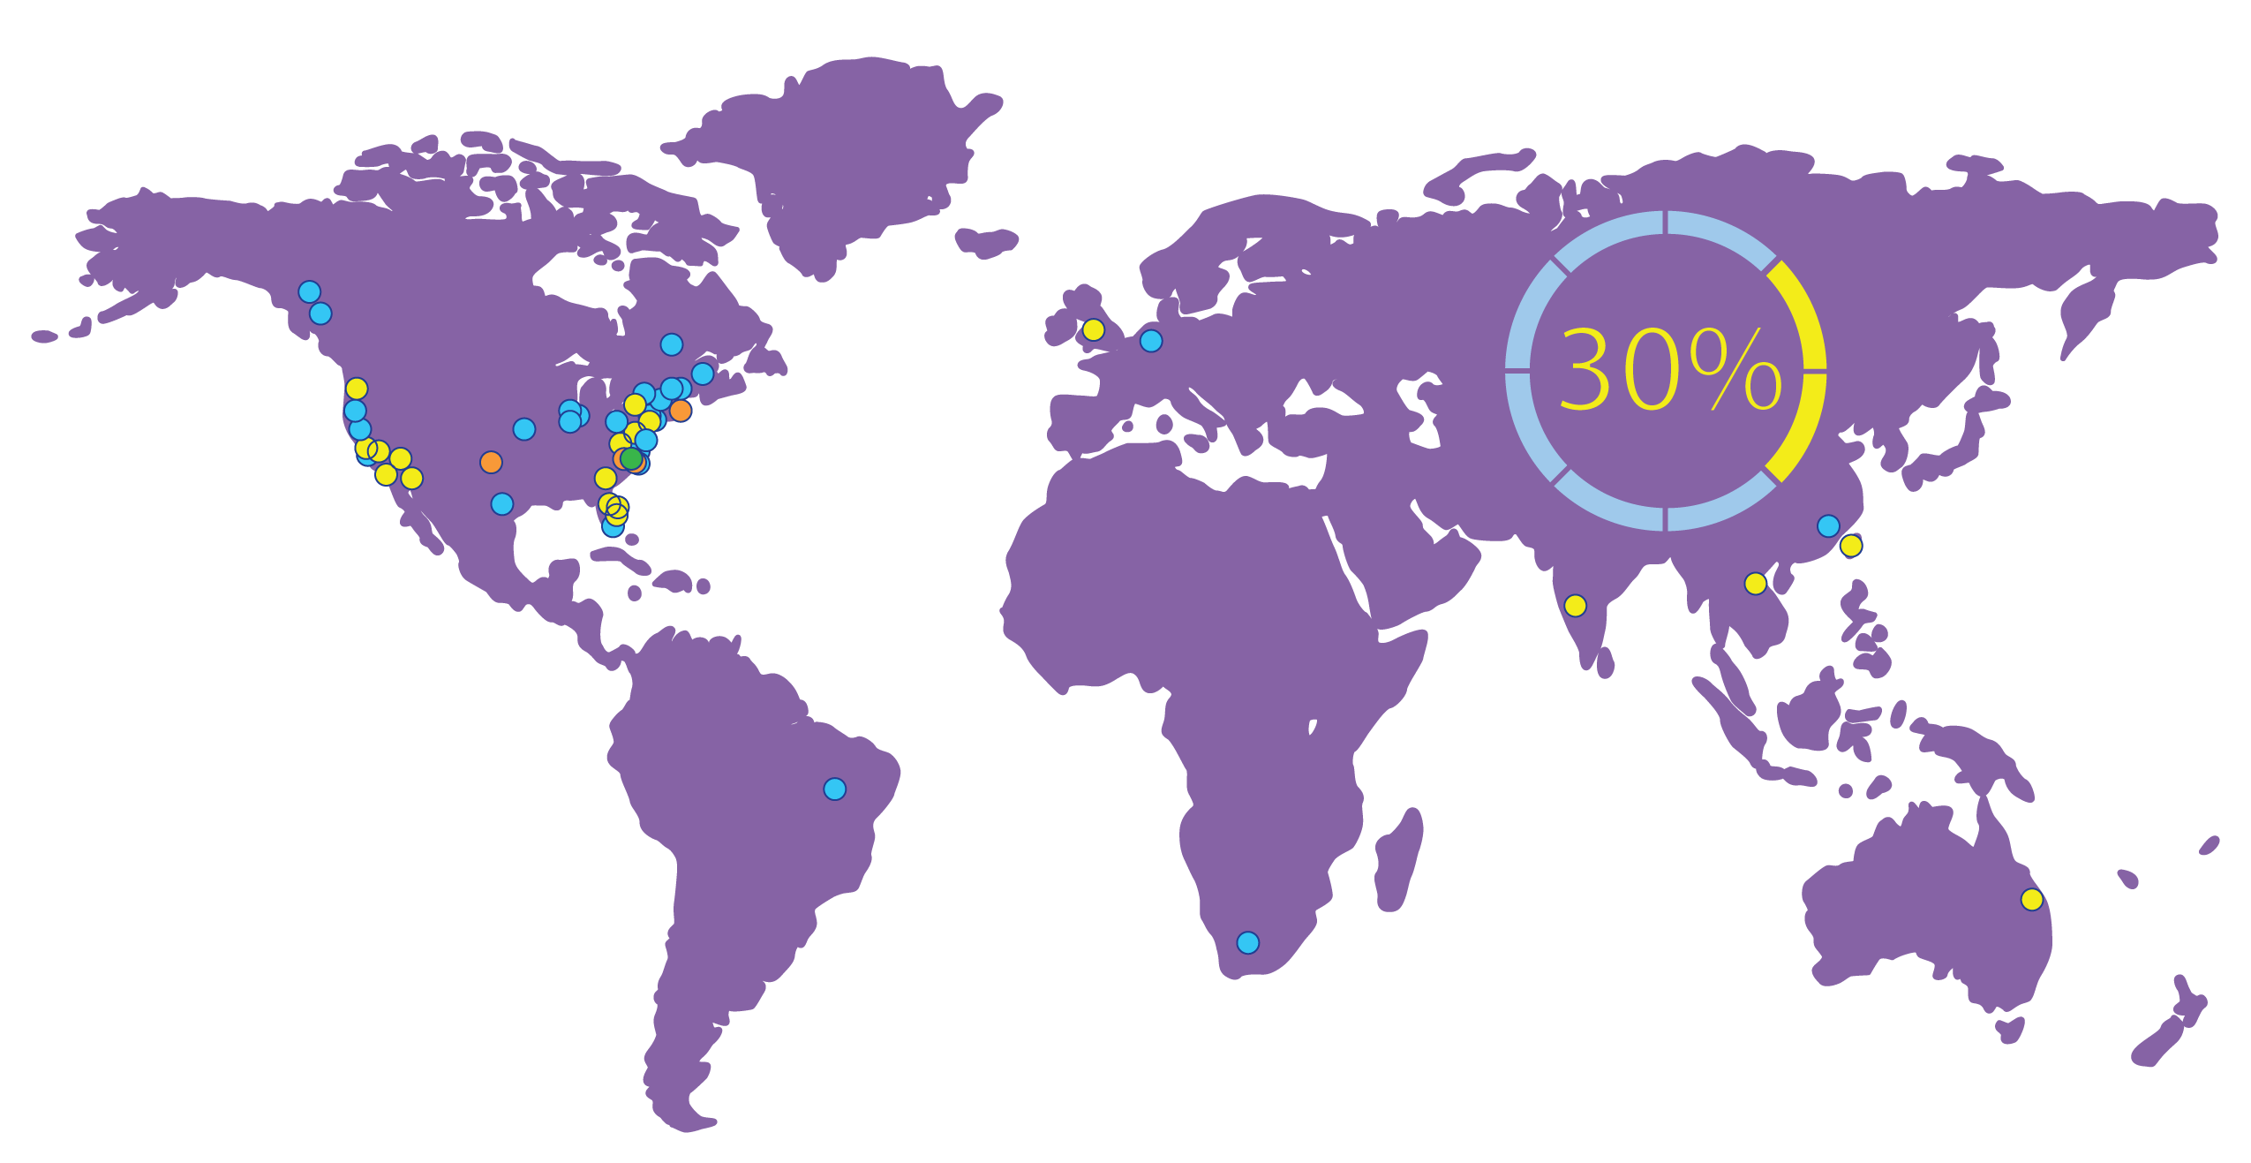
2015 Projects by Location
30% OF NCEAST PROJECTS ARE
COMING FROM INTERNATIONAL LOCATIONS
#LOGISYNERGY

Slide 29
Direct Company Engagement
EVENTS
Food Automation & Manufacturing
BIO 2015
Paris Air Show
NC Aerospace Suppliers Conference
Filtration Show
Process Expo
California Direct
United Kingdom Mission
Nordic Life Science Days
More detail on page 10 in annual report
#LOGISYNERGY

Slide 30
Engaging Consultants
EVENTS
IAMC Spring & Fall Conferences
Site Selector’s Guild
Area Development Consultant’s Forum
IAMC Carolinas Chapter Meeting - Boeing
Alliance engaged in community evaluation session by team of four site selection consultants
Alliance, allies & local EDs recently hosted 5 site location consultants in region to discuss trends, issues, and opportunities
More detail on page 10 in annual report
#LOGISYNERGY

Slide 31
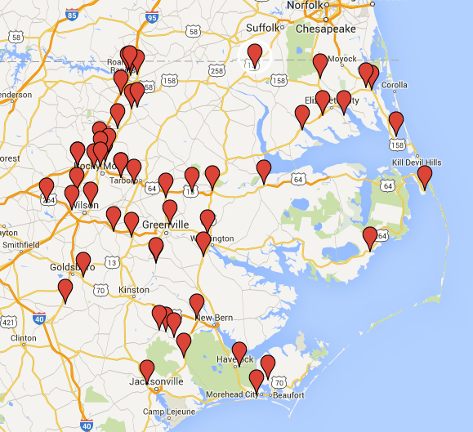
Product Inventory
NCCAR
REGIONAL INDUSTRIAL
CORPORATE PARKS
Kingsboro
Mega Site
GTP

Slide 32
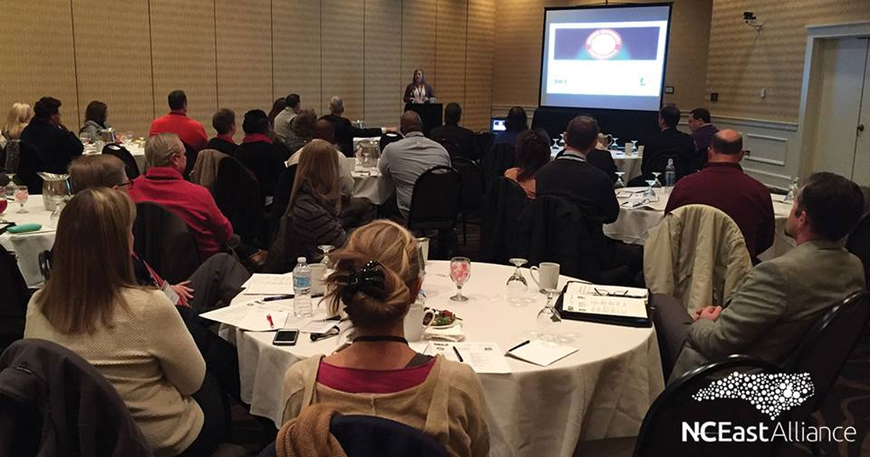
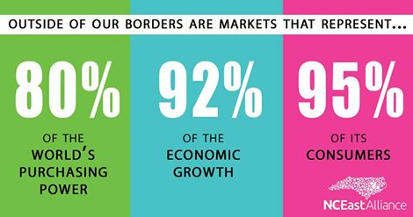
EXPORT 101
Event hosted by the NC District Export Council and the US Commercial Service, in partnership with the North Carolina East Alliance.
Export University is a series of courses on exporting designed to help U.S. companies gain skills and innovation in international sales.
Designed for businesses and individuals - both new-to-export as well as seasoned exporters - that would like expert advice and an overview of the export process fundamentals.

Slide 33
Economic Development Trends
ACCORDING TO SITE SELECTION CONSULTANTS
RE, labor/talent and utilities are THE key factors
Friendly permitting process
Clusters are important and subject matter experts need to be on the team
Data drives decisions: need good commuting data
(25/45/55 minute drive time maps)
Studies show regional EDO’s are the preferred point of initial contact for site location consultants
Best econ devs are resource brokers not salespeople
#LOGISYNERGY

Slide 34
Trends Influencing Site Location
Attributes: The education level of the workforce, attainment level and skill levels present in a community.
Talent: Can skills gap be filled and are there resources and tools in the prospect community to fill those gaps?
Pipeline: Can enough pipeline of skilled talent be developed to meet expected turnover and future growth?
Community: Where will a company’s employees live and where will they work? How they will get there? Shopping opportunities, quality schools and availability of executive housing do matter.
http://www.businessclimate.com/5-trends-influencing-site-location
#LOGISYNERGY

Slide 35
Site Selection Factors
Availability of Skilled Labor
Highway Accessibility
Quality of Life
Occupancy or Construction Costs
Available Buildings
Labor Costs
Corporate Tax Rate
Proximity to Major Markets
State & Local Incentives
Energy Availability & Costs
Area Development Corporate Survey 2015
#LOGISYNERGY

